Slide 1
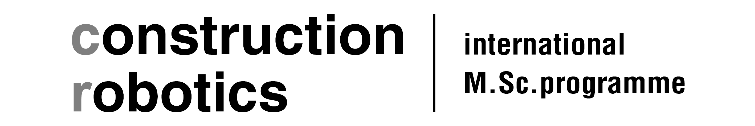
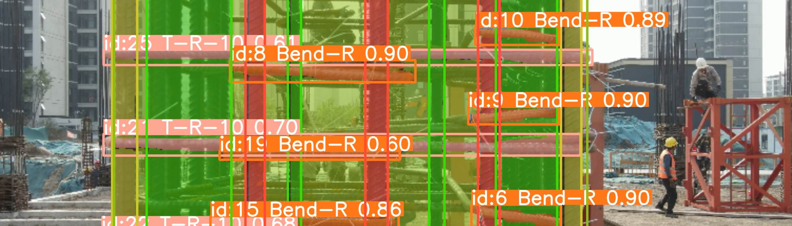
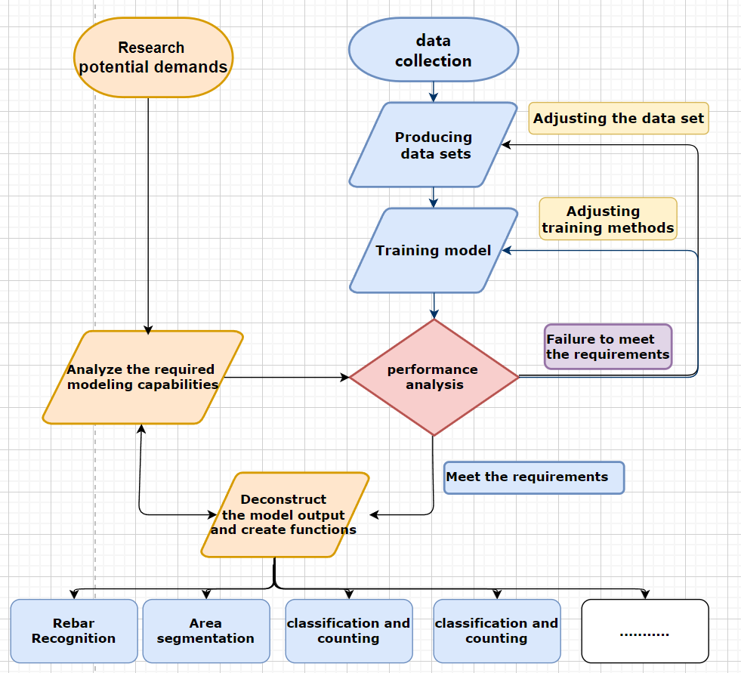
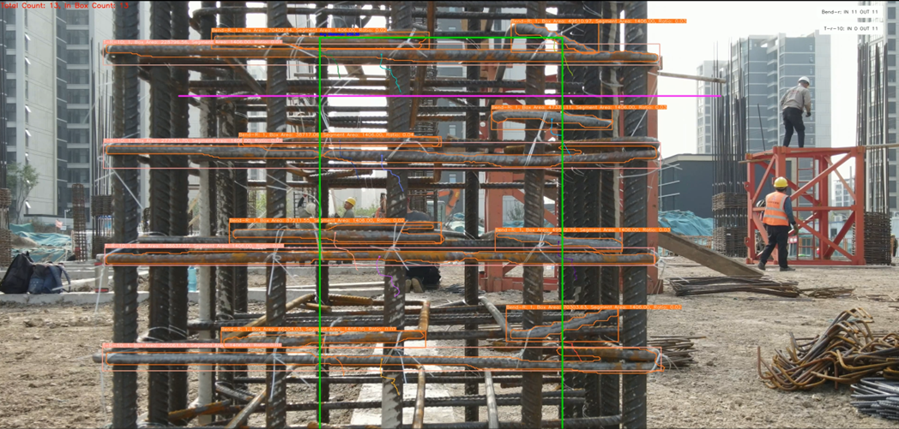
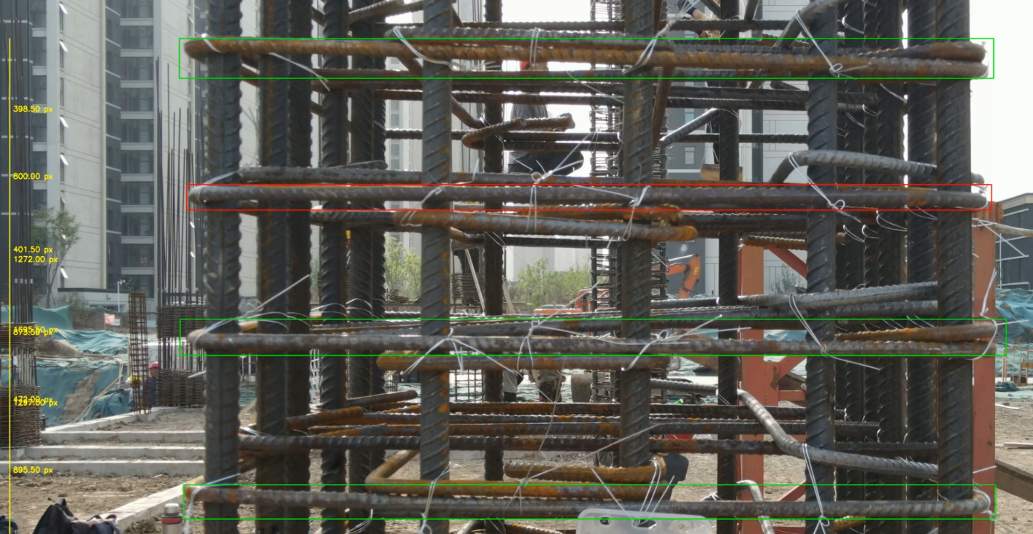


Research Driven Prototypes SS2024
SmartRebar counting:
Can Yolo contribute to Reinforcement Monitoring processes?
Fig.1 YOLOv8 model training for rebar detection, labeling positions and classifications
Introduction
Research on the use of AI at construction sites began to gain popularity in the early 21th century, but most of the focus has been on non-productive functions such as helmet detection and material counting.[1]. This research project focuses on the potential role of AI in the production process and addresses the following research questions:
Can the real-time detection model YOLO identify stirrups, longitudinal bars, and other reinforcements tied to columns and beams?
With the addition of segmentation and tracking layers, can YOLO analyze area and count information?
Can YOLO recognize the relative positions of stirrups or longitudinal bars in 3D space?
We hope that through our research, more AI-based production tools will be designed and developed to accelerate the digitization of the construction site production process.
Development
Our research process, as illustrated in Fig.3, involves specific roles and responsibilities.
Zonghai YANG is primarily responsible for data collection, creation of training sets, and model adjustment and training. This includes video collection, frame extraction and annotation, training set augmentation, model training, and hyperparameter tuning, with the goal of enabling the model to accurately determine the types of rebar and their spatial positions.
Xingying LI is mainly responsible for analyzing the model's outputs, particularly focusing on the front-row rebar content. This involves initializing the YOLOv8 model with pre-trained weights, using OpenCV for video capture, and processing video frames to detect objects.
development process
^{Fig.2}
Results
After completing 30 real-world images of columns and 30 real-world images of beams from the construction site, we expanded the dataset to 1700 images. This was achieved by altering the brightness (brighter *2, darker *2) and color temperature (cooler *2, warmer *2) of the patterns, as well as manually modifying the backgrounds(*2).
The analysis produced annotated video frames detailing the detected rebars. Bounding boxes with class-specific annotations were drawn for clear identification. Visual indicators, including lines and text annotations, highlighted distances between rebars. Additionally, color-coded bounding boxes emphasized when distances exceeded a specified threshold.
Using this augmented dataset, we trained a model that can distinguish the 3D spatial information of rebar. However, due to the initial limited data, our model still suffers from a series of overfitting issues. These problems can be mitigated by collecting and annotating a more comprehensive dataset that include different types and numbers of columns and beams.
^{Figure 3}
Out put of our model – counting and distance analysis
Conclusion
The SmartRebar project shows great promise in improving rebar inspections on construction sites. Using the YOLOv8 model for real-time detection, it reduces material waste and supports sustainable practices. Future improvements will focus on increasing model accuracy and speed, expanding the dataset, and adding features for better site monitoring. Additionally, using higher precision cameras will enhance detection accuracy. Integrating the system with AR headsets will provide real-time, interactive inspections, helping workers visualize rebar placements more effectively. Incorporating Building Information Modeling (BIM) will further streamline planning, execution, and management of construction projects.
Sources:
[1] Yang J, Park M-W, Vela P A and Golparvar-Fard M 2015 Construction performance monitoring via still images, time-lapse photos, and video streams: Now, tomorrow, and the future Advanced Engineering Informatics 29 211–24.
[1] Redmon, J., & Farhadi, A. (2016): You Only Look Once: Unified, Real-Time Object Detection. Proceedings of the IEEE Conference on Computer Vision and Pattern Recognition (CVPR), 2016, 779-788. DOI: https://arxiv.org/abs/1506.02640
[2] Hussain, M. (2024): YOLOv5, YOLOv8 and YOLOv10: The Go-To Detectors for Real-time Vision. arXiv preprint. DOI: https://arxiv.org/abs/2407.02988
[3] Ultralytics (2023): YOLOv8 Documentation. Available at: https://docs.ultralytics.com
.
Zonghai Yang
Zonghai.yang@rwth-aachen.de
Xingying Li
xingying.li@rwth-Aachen.de
Tutor:
Dr.-Ing. Thomas Adams
Univ-. Prof. Dr. Sigrid Brell-Cokcan
Individualized Production, RWTH Aachen
Director of CR-Master
Univ-. Prof. Dr. Sigrid Brell-Cokcan
Individualized Production | RWTH Aachen

